Slide 1
STUDENT ATTENDANCE SYSTEM AND LIVE TRACKING

Slide 2
PROBLEM :
Daily attendance marking is a common and important activity in institutions which is mainly undertaken manually.
This Manual Attendance maintaining is difficult process, especially for large group of students.
Many times results in inaccuracy, fake attendance, etc.
Also, it is a time consuming process that requires manual efforts for monitering and cross checking for fake attendance and other mistakes.

Slide 3
PROPOSED SOLUTION :
These drawbacks could be overcome by a smart and automated attendance system .
A "Student's attendance and live tracking system " based on facial recognition tracks the presence of student; live, and automatically maintains their attendance on the bases of time duration of their presence.
Since, face is a unique identity of person, by using a system based on Face Recognition the issue of fake attendance, inaccuracy and proxies can be solved.
It also reduces manual efforts of taking attendance and tracking false attendance and proxies, as it is an automated system which tracks the presence of student and mark their attendance.

Slide 4
TECHNOLOGY USED
The system is implemented using Python Programming Language.
It makes use of :
Face Detection
Face Recognition
with the help of Python's libraries such as :
CV2 : An openCV library for Image processing .
NUMPY : For computing, processing and performing various operations on arrays (as an image is an array of pixels values) .
MATPLOTLIB, PIL : for capturing, opening and saving the image set as a file.
Tkinter : for making the graphical user interface of the application.
CSV : for storing attedance data in a CSV file formate.
OS : for performing operations over system paths .
re, datetime : for other internal computations.

Slide 5
MINIMUM REQUIRMENTS
HARDWARE REQUIRMENTS
The system requires a good resolution camera for accurate capturing and recognition of faces, minimum 10 MP .
Minimum 4 GB RAM and 1.6 GHz processor for installing and running software.
SOFTWARE REQUIRMENTS
Python Virtual Machine (PVM) installed on PC for running the software .

Slide 6
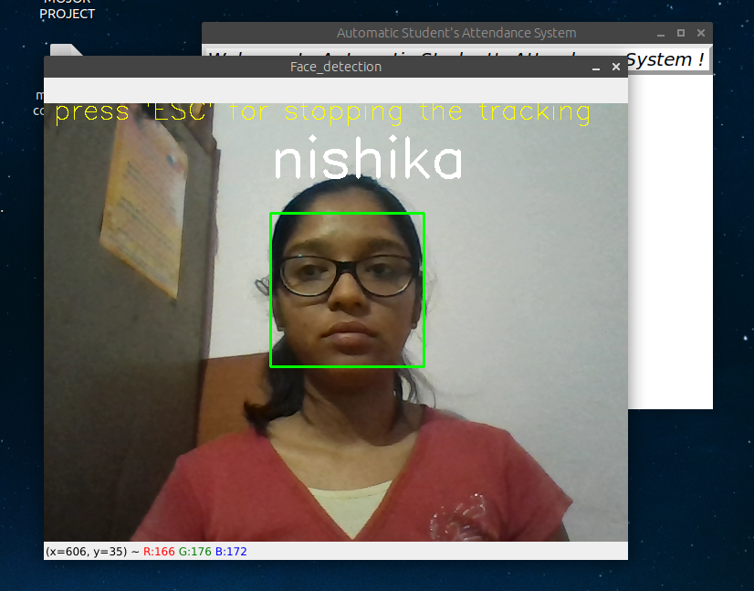
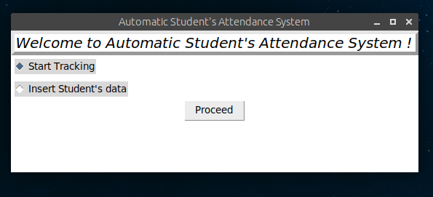
SCREENSHOT
MAIN WINDOW
TRACKING AND IMAGE RECOGNIZATONA

Slide 7
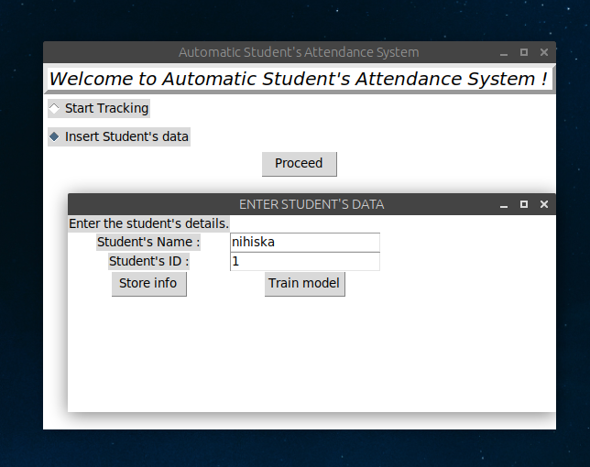
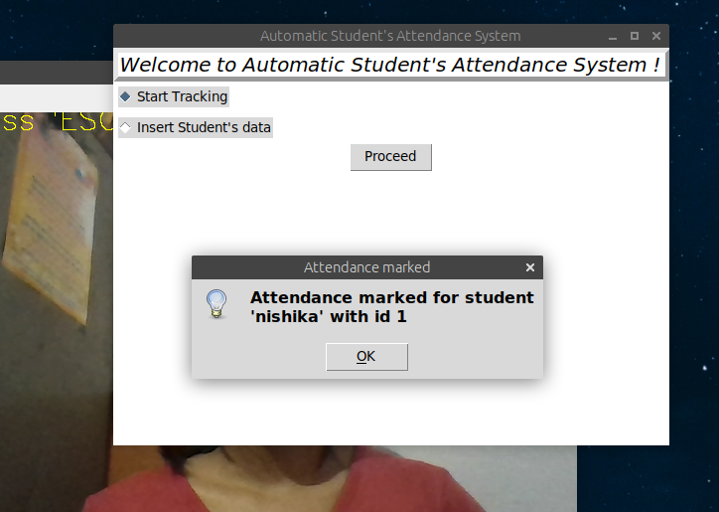
SCREENSHOT
INSERTING TRAINING DATA
ATTENDANCE MARKING

Slide 8
SYSTEM FLOW CONTROL
The system is built upon MVC design architecture
model.py
model.py : It manages all the updations and maintainance (attendance marking, attendanec file creation, etc.) of CSV files.
Imported in
controller.py
controller.py : It takes all the event requests from "views.py" , process it, and sends the response back .
Also forwards the requests to model.py, if required, accepts & transfers the response back to views.py
Imported in
views.py
views.py : Contains all the GUI (Front end) of app. Takes all the requests.

Slide 9
ALGORITHM
1. Object(face) tracking on the video
(face detection +tracking)
2. Capturing face samples and storing it.
3. Creating and training face detection "model" (.yml file)
5. Attendance marking (csv file updation)
4. Face detection
+
Face recognization
+

Slide 10
Face Detection :
HARCASCADE CLASSIFIERS (which internally uses "FEATURE MATCHING algo") is used for face detection.
By passing 'cascade'(series) of 'classifiers' ('predefined features' which are nothing but group of arrays of 'float values' i.e. a matrix, denoting the grey color point of an image.
As, an image is nothing but a matrix of floating point numbers.
Face Recognization :
LBPH recognization algorithm is used for facial recognization.
It compares the input facial image with all facial images existing inside the dataset, with the aim to find the image that best matches that face.
It is basically a 1xN comparison.

Slide 11
FLOW OF DATA : Taking image records
Take image & increse image list by 1
Display messag
If (Image
list <= Total students)
Insert number of total students
YES
NO
Data set
Data stored!

Slide 12
FLOW OF DATA : Attendance and Tracking
Attendance Updation
FALSE
TRUE
If (Image is recognized for time ‘t’ sec)
Face detection
Face recognition
Image acquired
Tracking
DB
Updation
For each frame

Slide 13
FUTURE SCOPE
Since it's an automated attendance & tracking system so it can be used in any institution or professional offices, thus, reducing manual efforts for the same.
As it has a real time tracking system and in coming future we can also add user access to their own tracking, thus, making it helpful for users to monitor and focus on themselves .

Slide 14
LIMITATIONS
The system will require a high resolution camera, as a device with lower resolution will result in inappropriate and inconsistent results.
The system will require fast processing speed, minimum 4 GB RAM , for fast and accurate facial tracking .
For initializing the system, the facial data of every student to be tracked needs to be provided.
The system can only accurately recognize those faces whose image data has been provided to the system.

